Slide 1
AUDIT MANAGEMENT SYSTEM

Slide 2
Problem Statement
A leading supply chain management organization is willing to automate the Audit processing in order to make the management scalable and ensure clarity and ease of tracking.
Therefore, it wants us to develop an Audit Management System.
As a full stack developer our work was to develop and deploy multiple microservices in Amazon Web Services (AWS).
The UI part was done with the help of ReactJs.

Slide 3
The project contains four microservices
MICROSERVICES
Audit Authorization
1
Audit Benchmark
2
Audit Checklist
3
Audit Severity
4

Slide 4
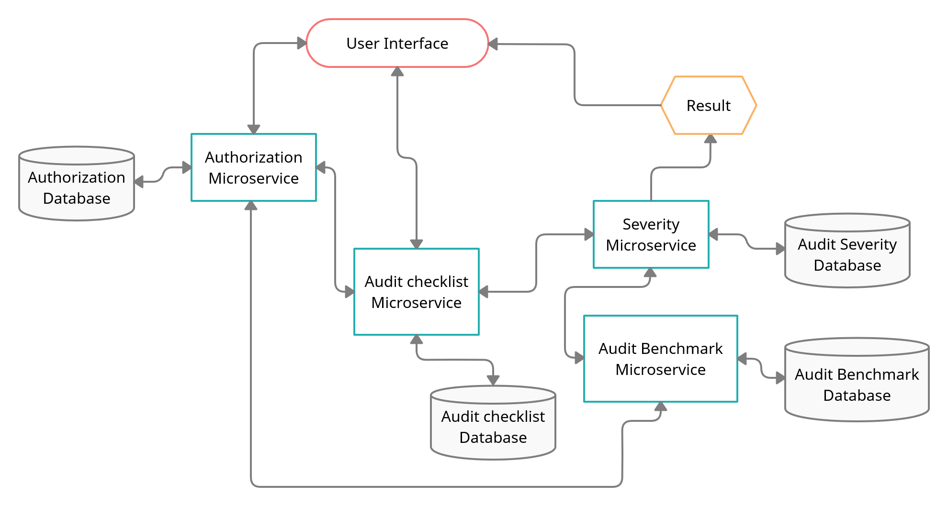
FLOWCHART

Slide 5
1. AUDIT AUTHORIZATION
Authentication and Authorization part of project.
It creates JWT (JSON Web Token) for an authenticated user is in Database and then it validates the user based on the JWT token passed in the "Authentication"-Request-Header.
Method:
GET:/health-check
POST:/login
POST:/validate

Slide 6
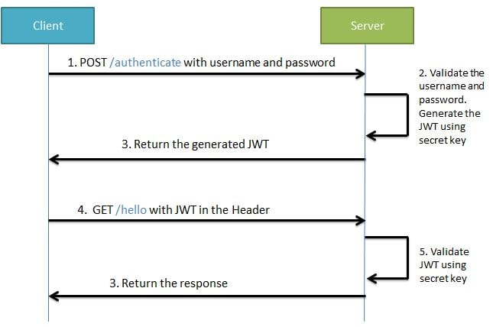

Slide 7
2. AUDIT BENCHMARK
It is a middleware microservice which stores the number of acceptable “No” in the database based on Audit Type.
It uses data.sql which stores Benchmark ID, Audit Type and Bechmark “No” answers.
It is used to pass the number of list of acceptable “No” to audit-severity microservice.
Method:
GET:/auditbenchmark
GET:/health-check

Slide 8
3. AUDIT-CHECKLIST
It is a middleware microservice which gets the list of questions from H2 database.
It uses data.sql which stores Question ID, Question, Audit Type and Response.
The returned list is used by the audit-severity to display questions based on the type selected by the user.
Method:
POST:/checklistquestions
POST:/saveresponses
GET:/health-check

Slide 9
4. AUDIT-SEVERITY
It is a middleware microservice which invokes audit-benchmark microservice and takes the list of acceptable “No” from it and it also takes questions from audit-checklist based on that generates the response.
It then checks the project execution status according to the pre-set rules.
It returns the status and remedial action to be taken.
Method:
POST:/projectexecutionstatus
GET:/health-check

Slide 10
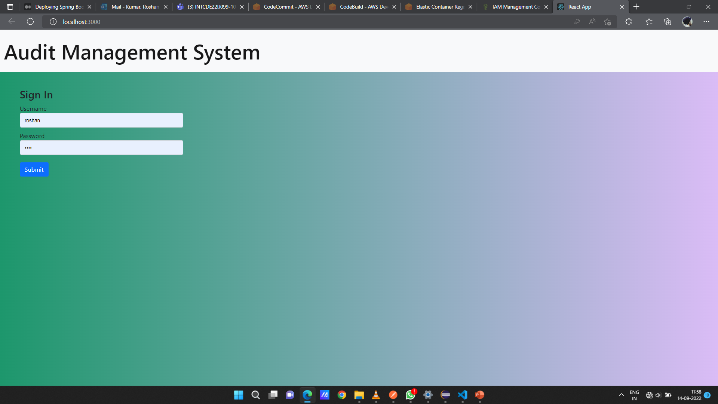
Login

Slide 11
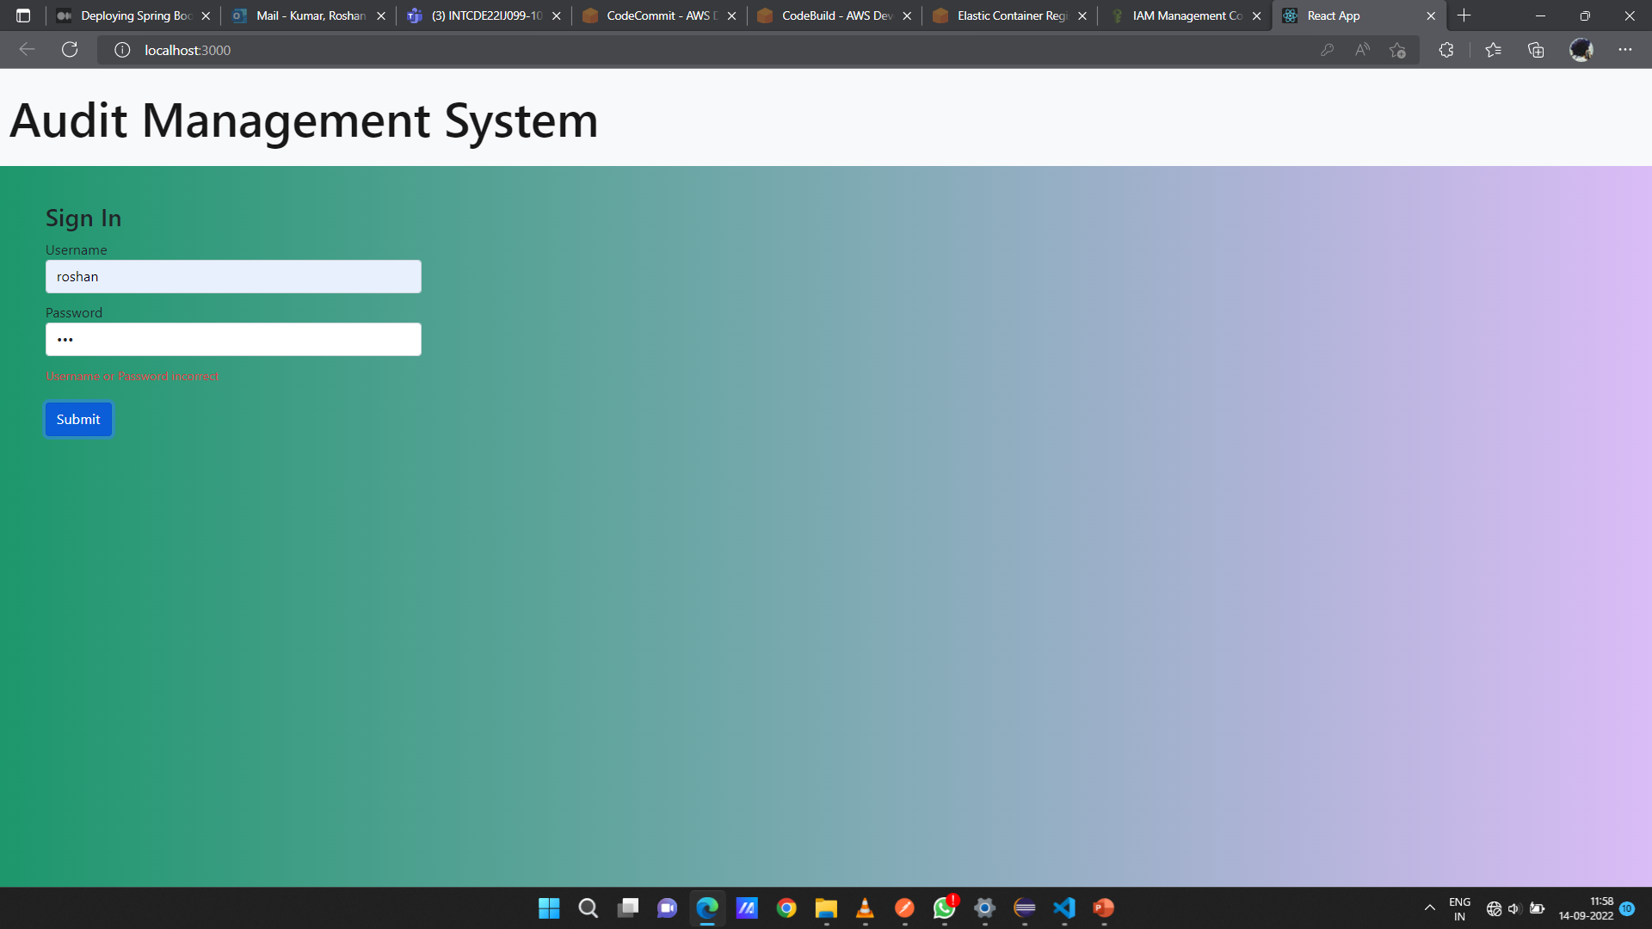
Login - validation

Slide 12
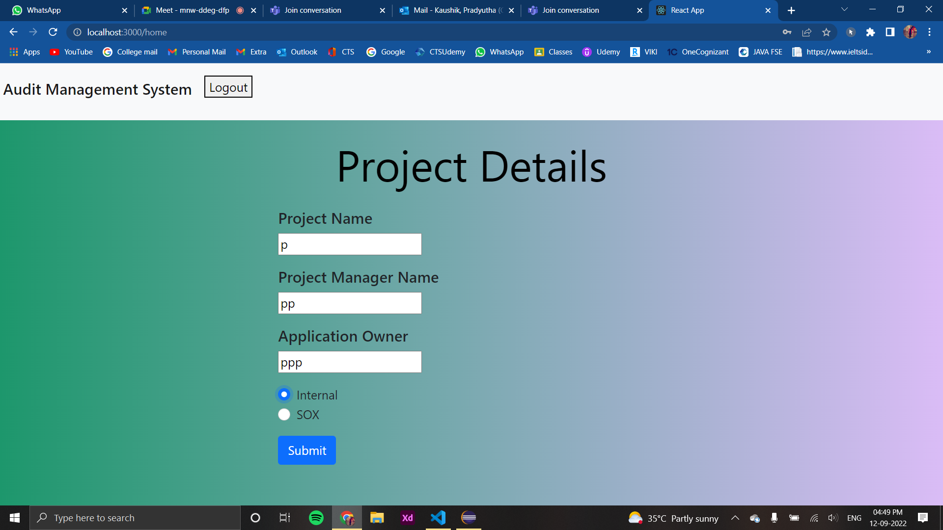
Project details

Slide 13
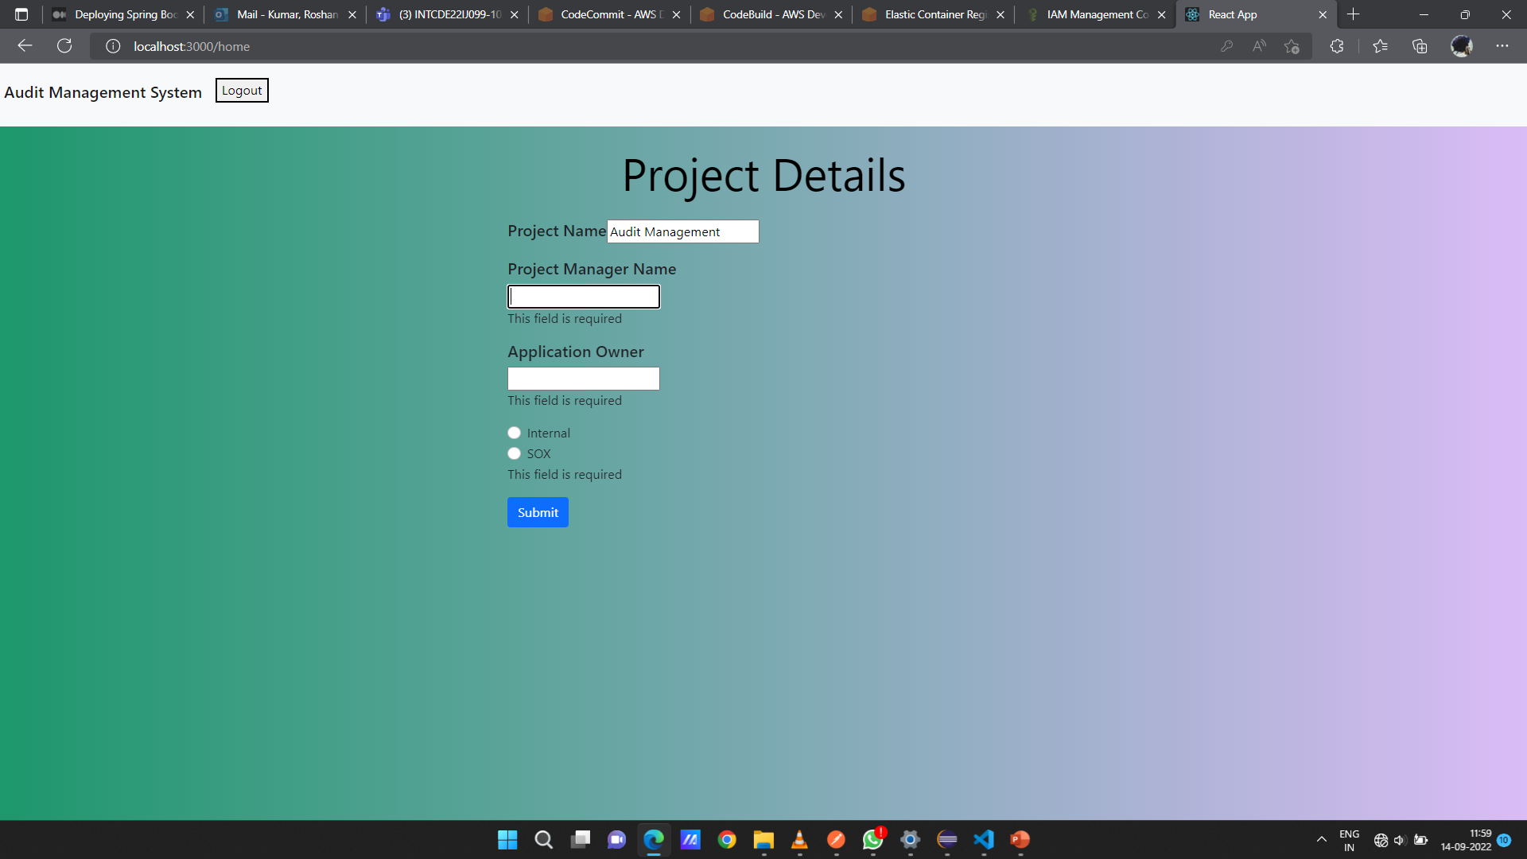
Project details - validation

Slide 14
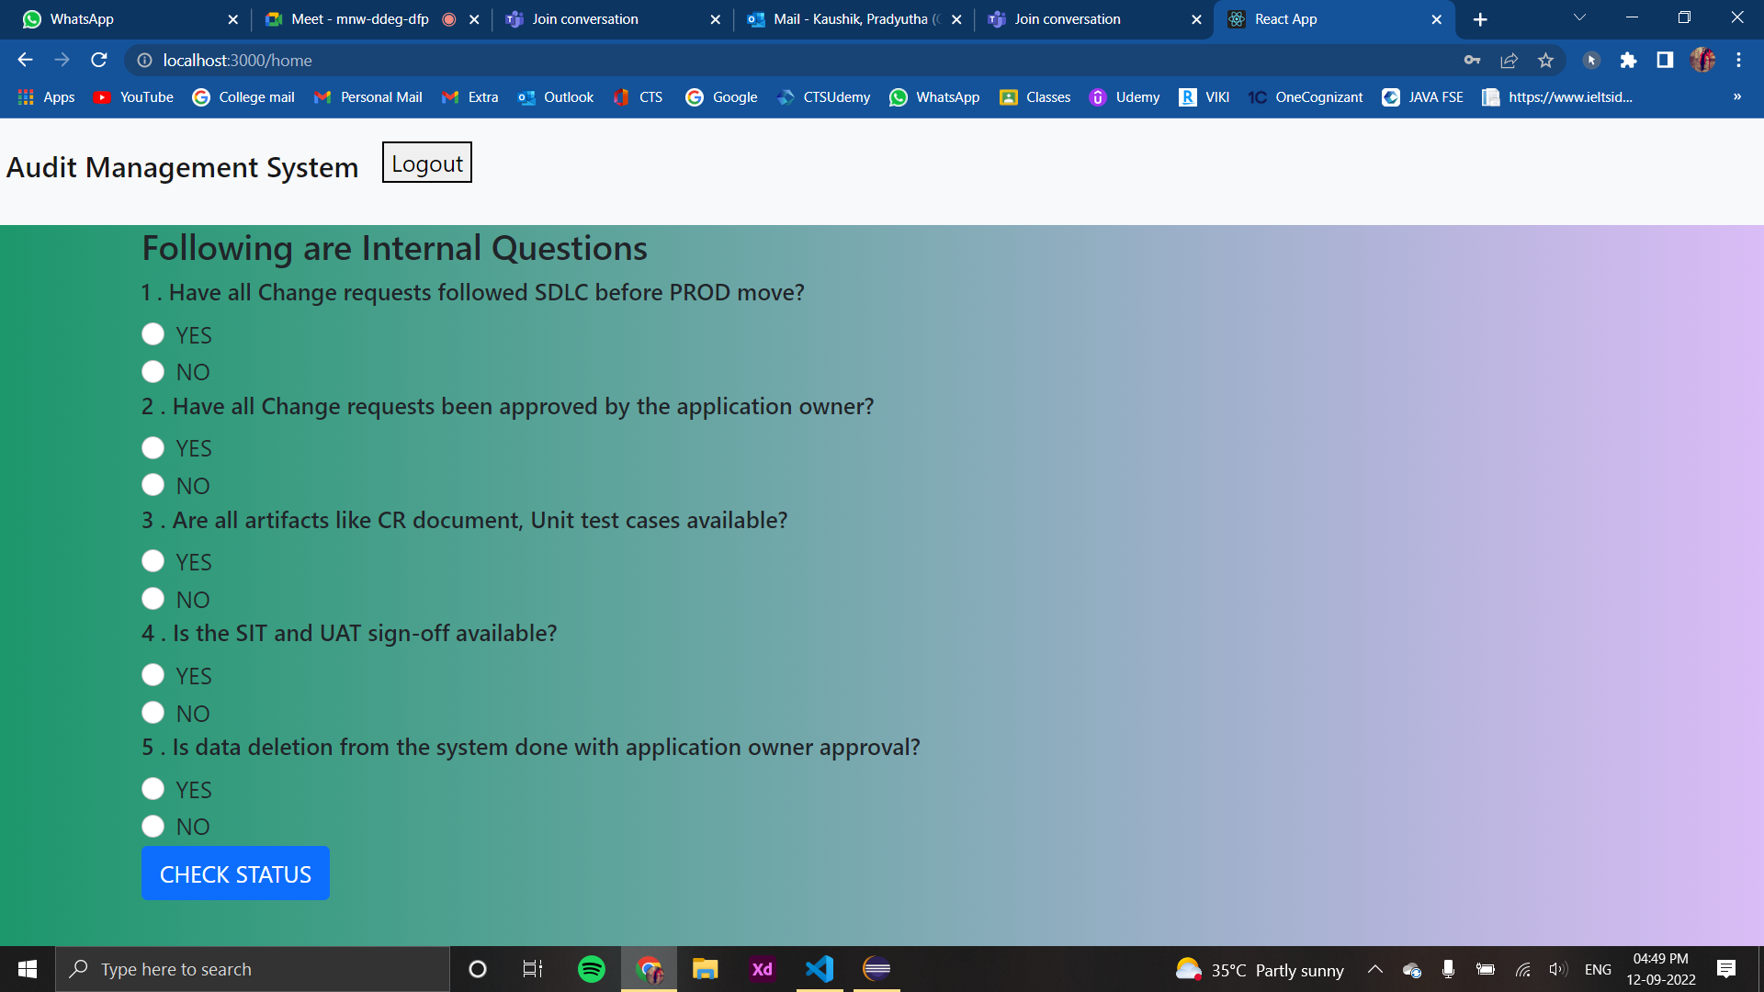
Questions

Slide 15
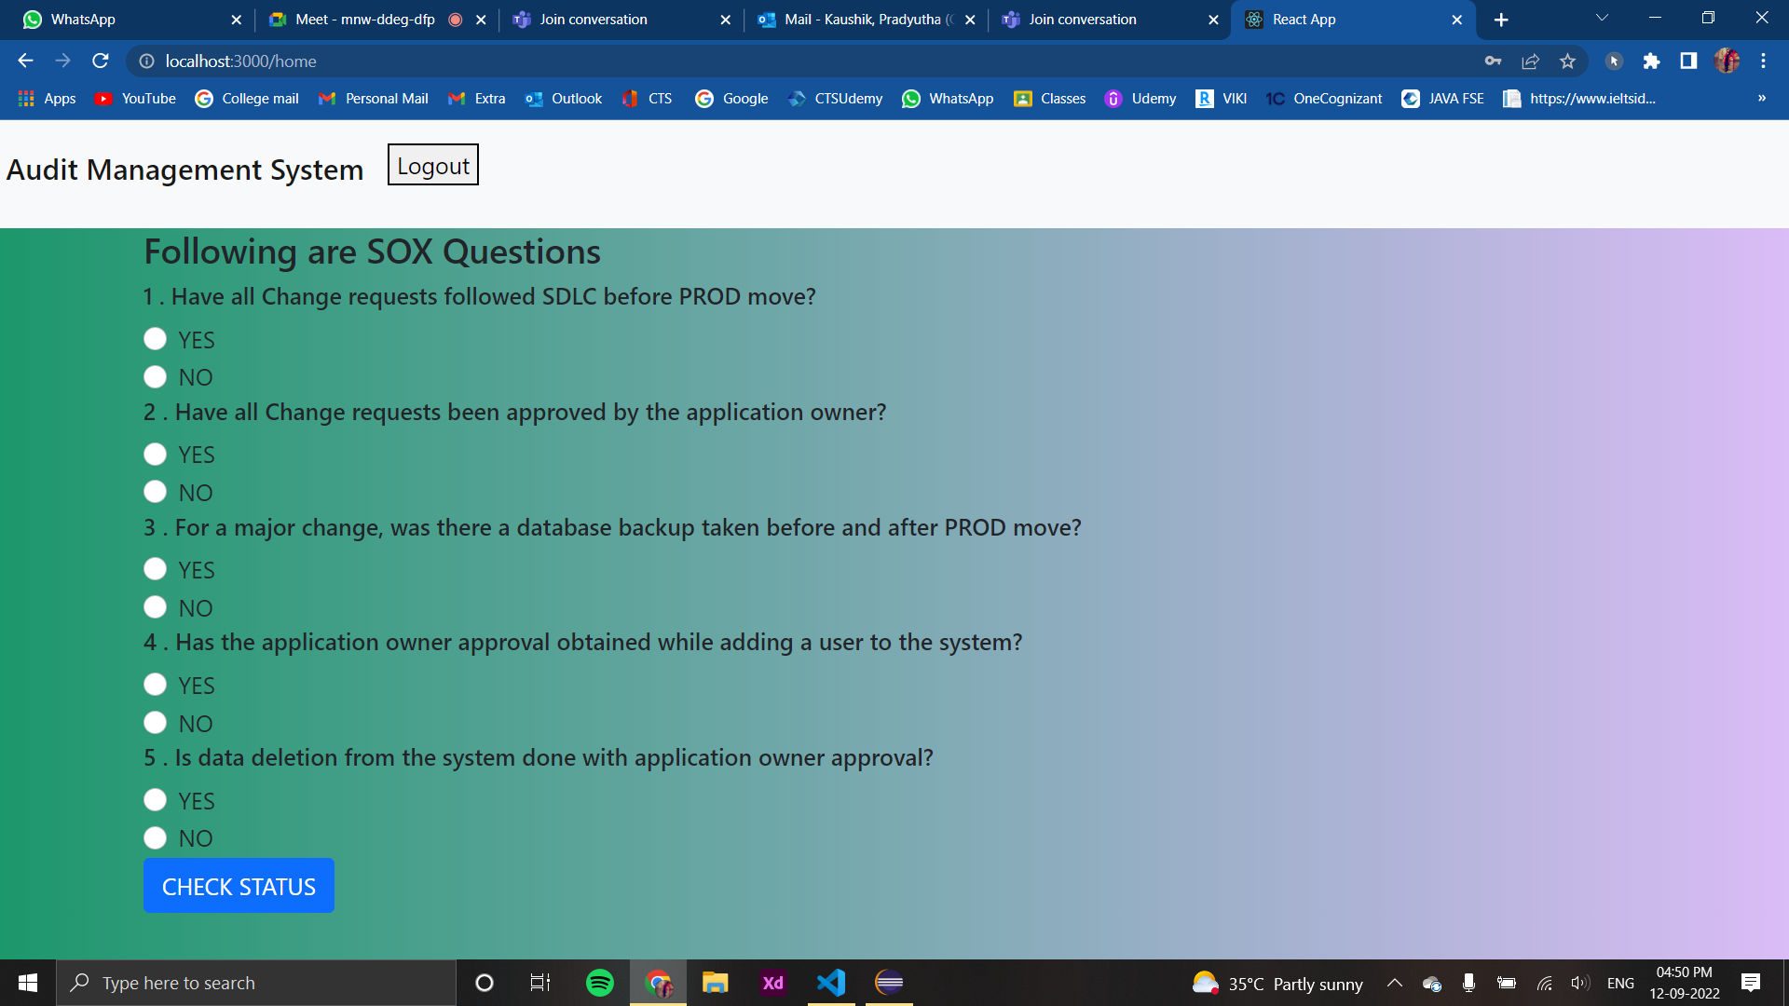
Questions

Slide 16
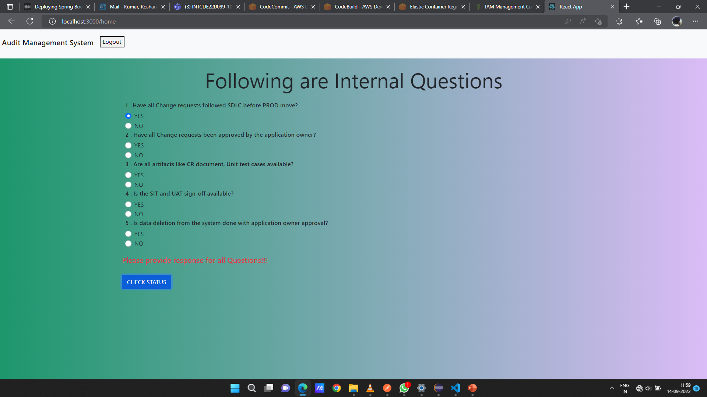
QUESTION-RESPONSE-VALIDATION

Slide 17
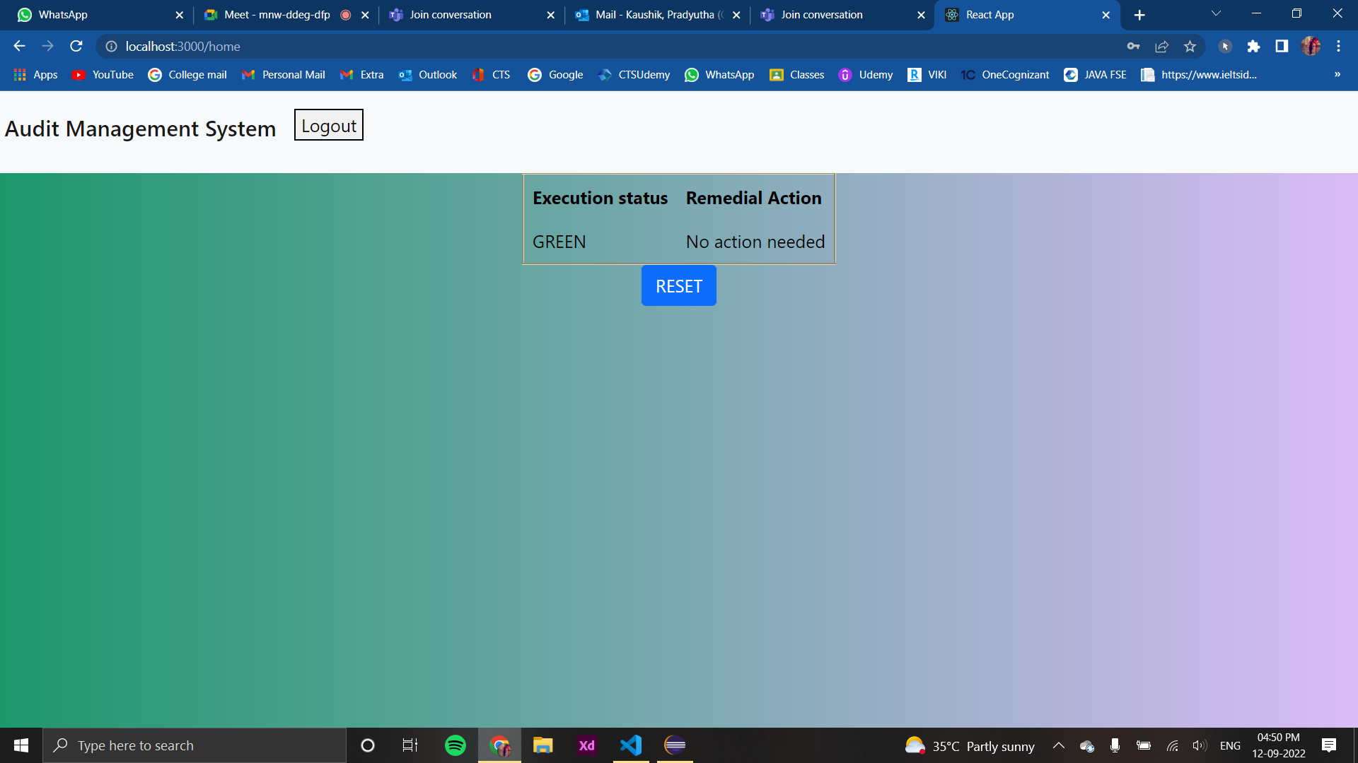
Result

Slide 18
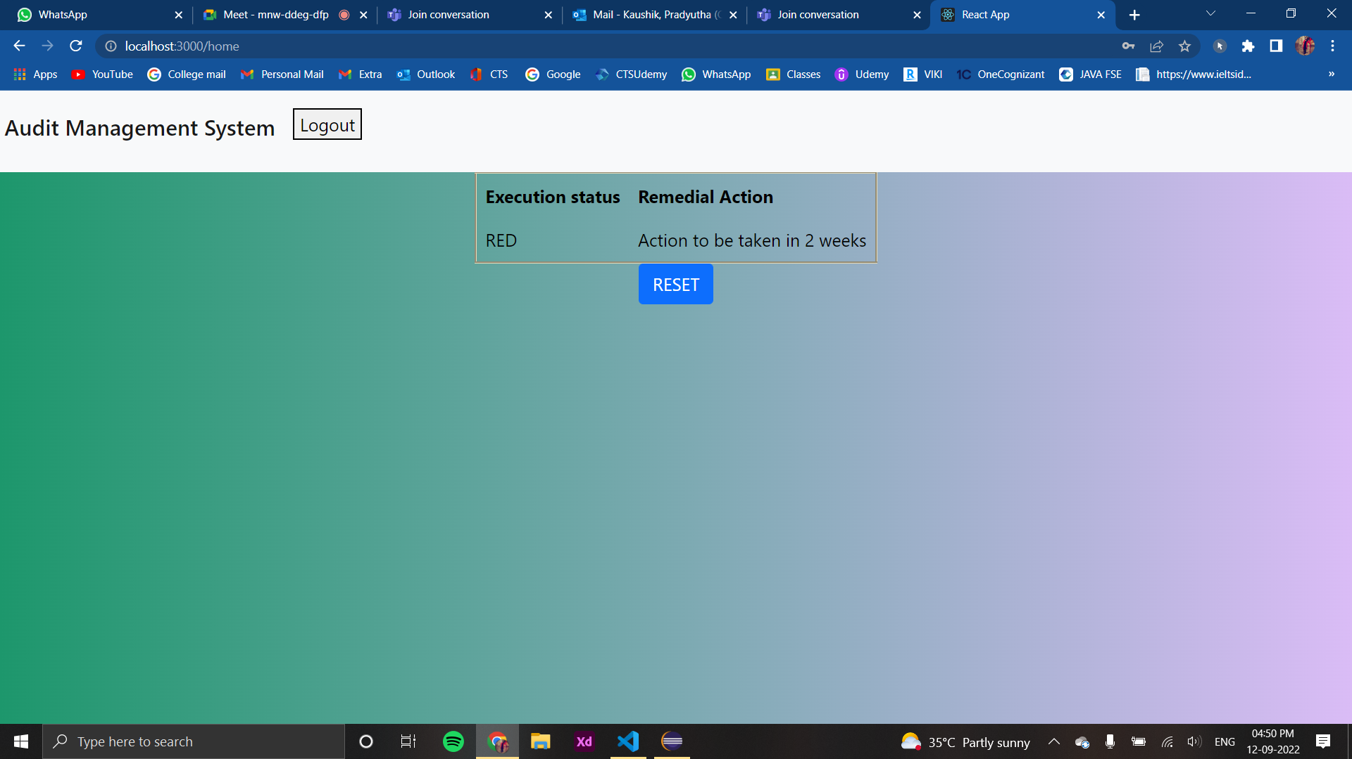
RESULT

Slide 19
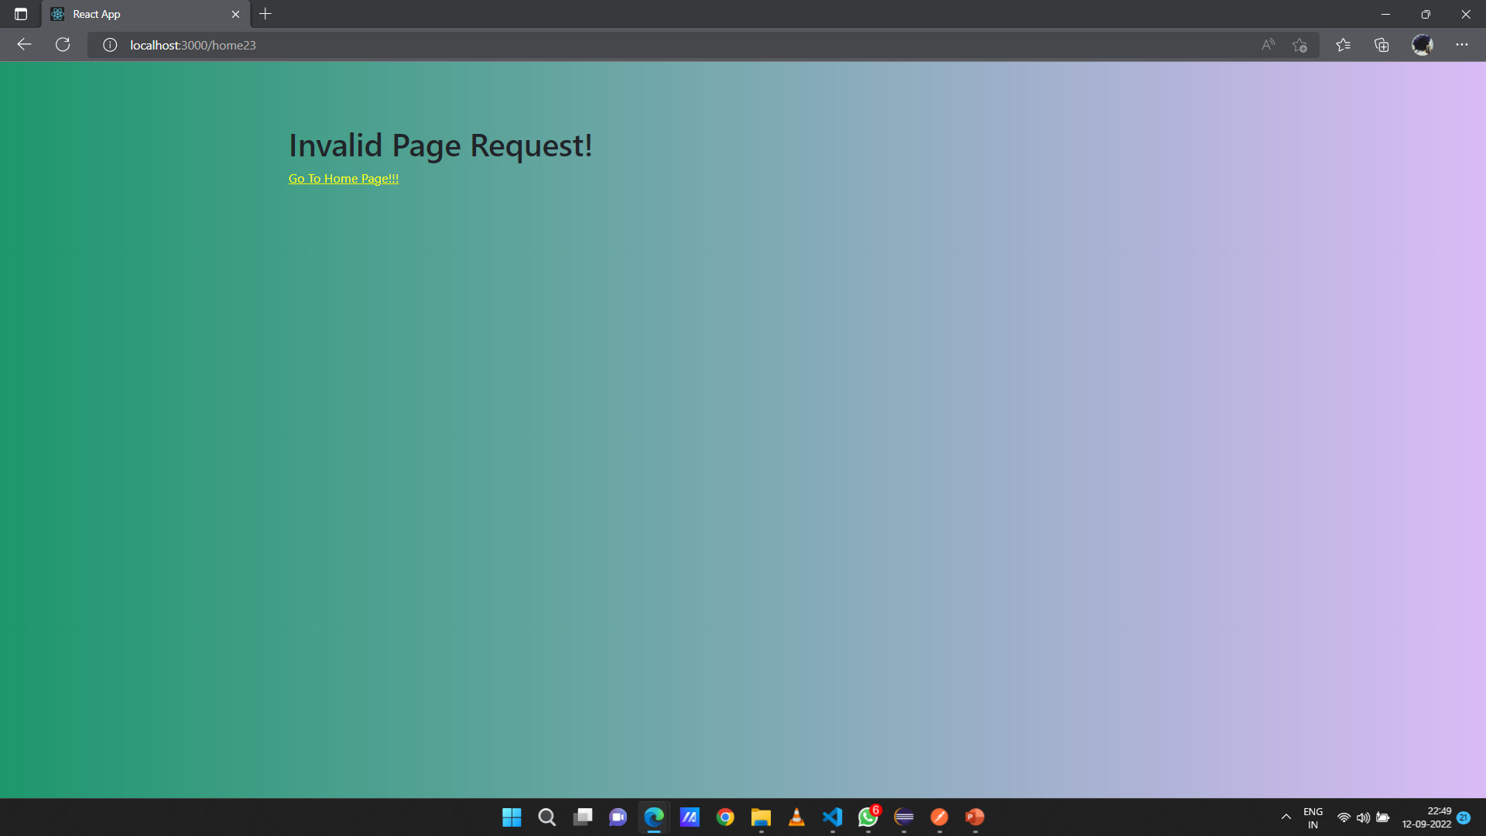
ERROR HANDLING

Slide 20
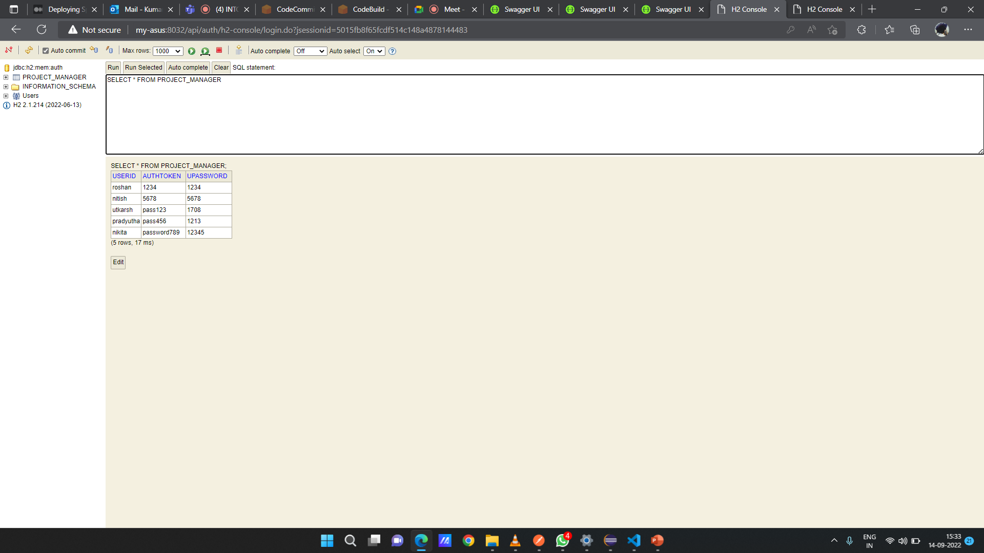
H2 DATABASE

Slide 21
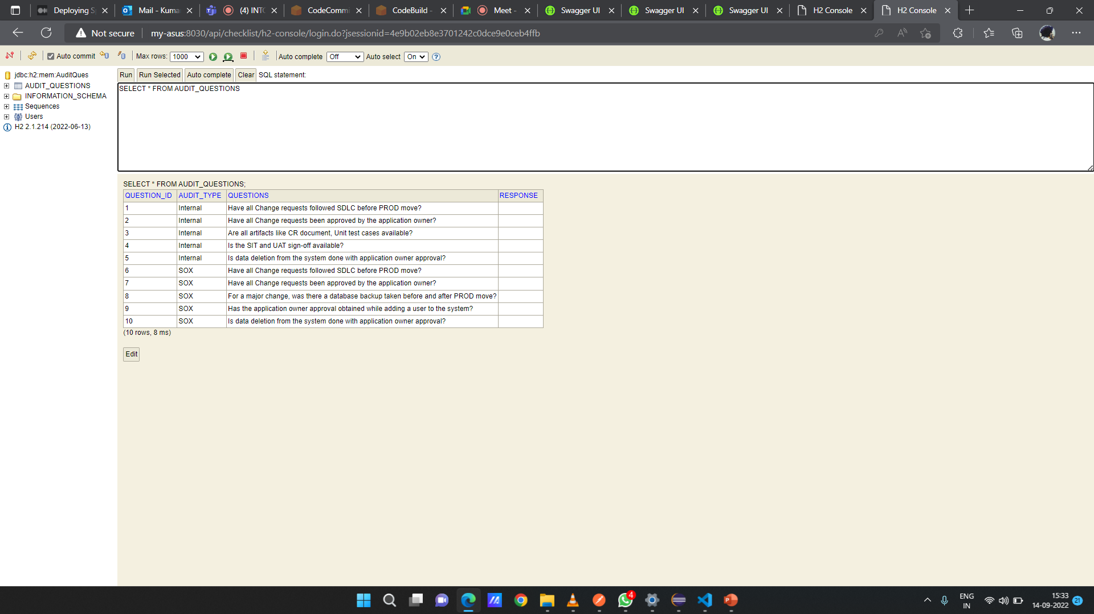
H2 DATABASE

Slide 22
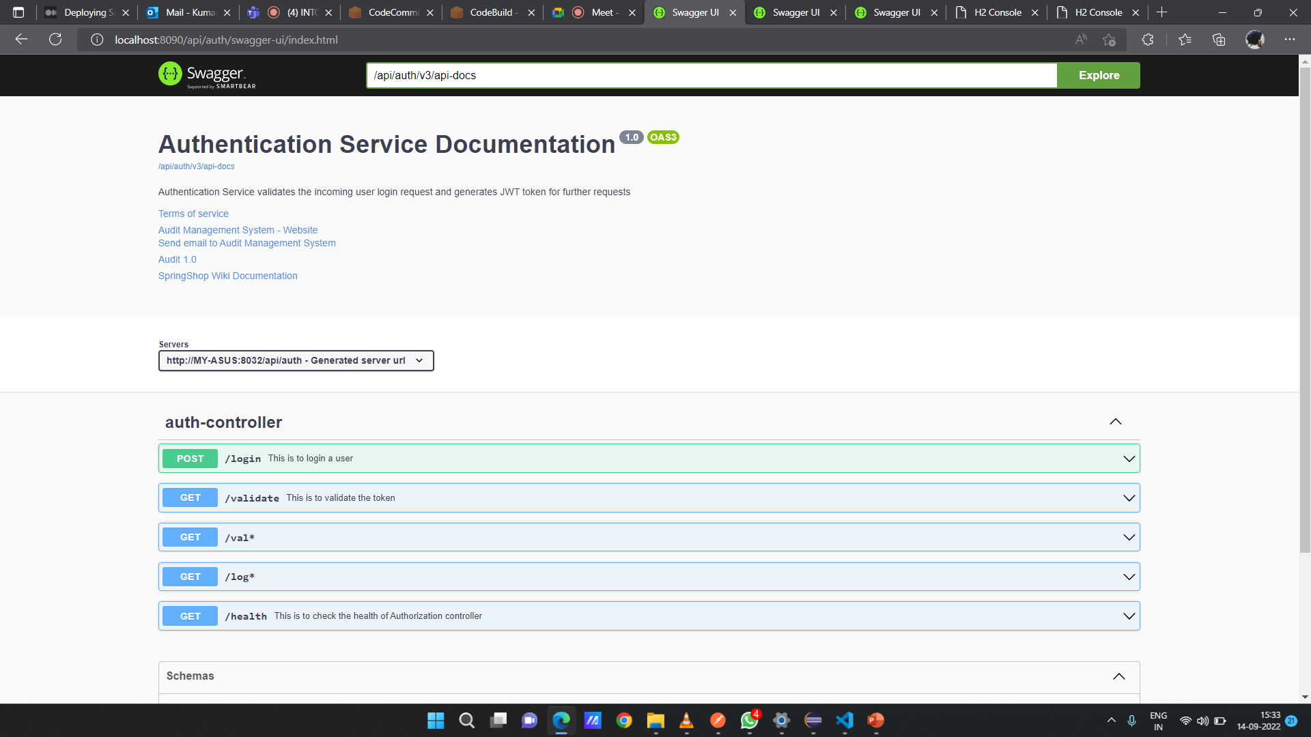
SWAGGER

Slide 23
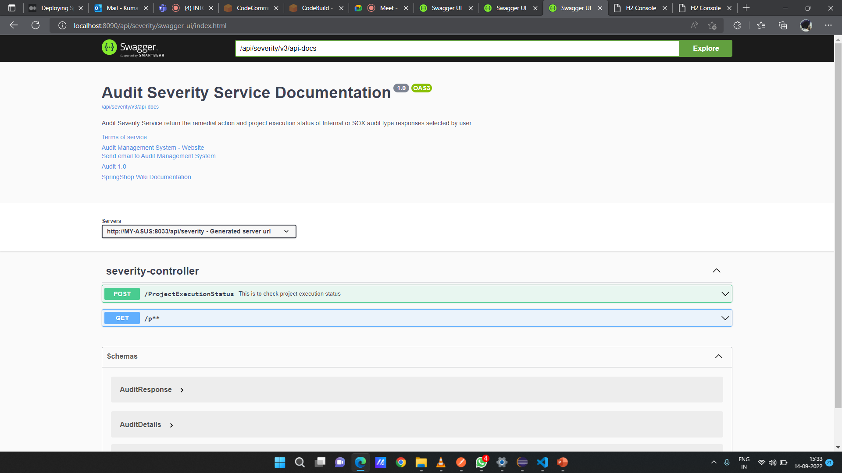
SWAGGER

Slide 24
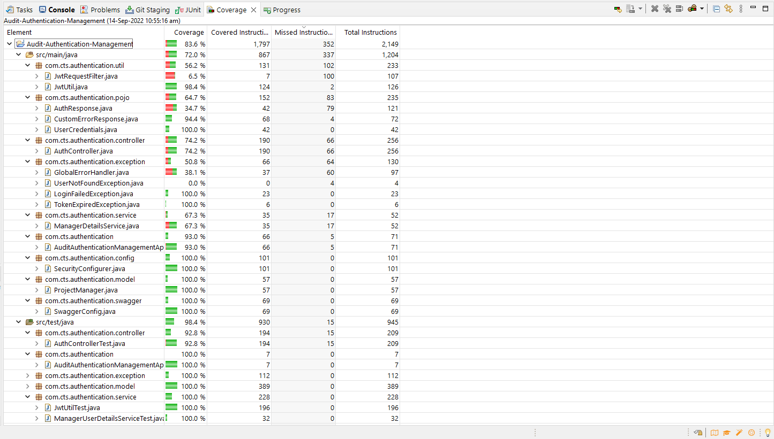
CODE COVERAGE

Slide 25
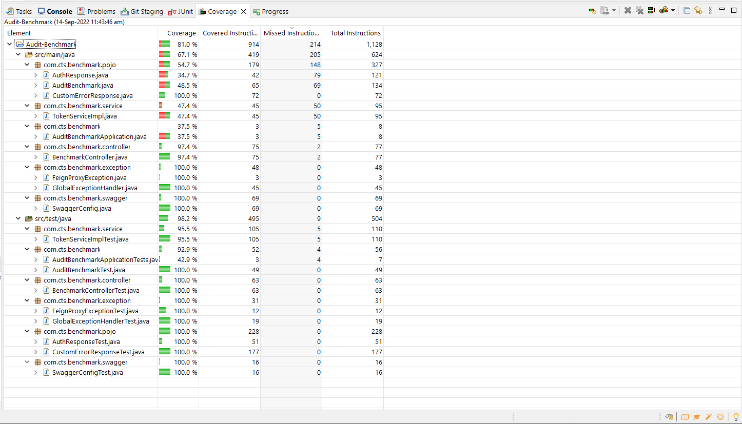
CODE COVERAGE

Slide 26
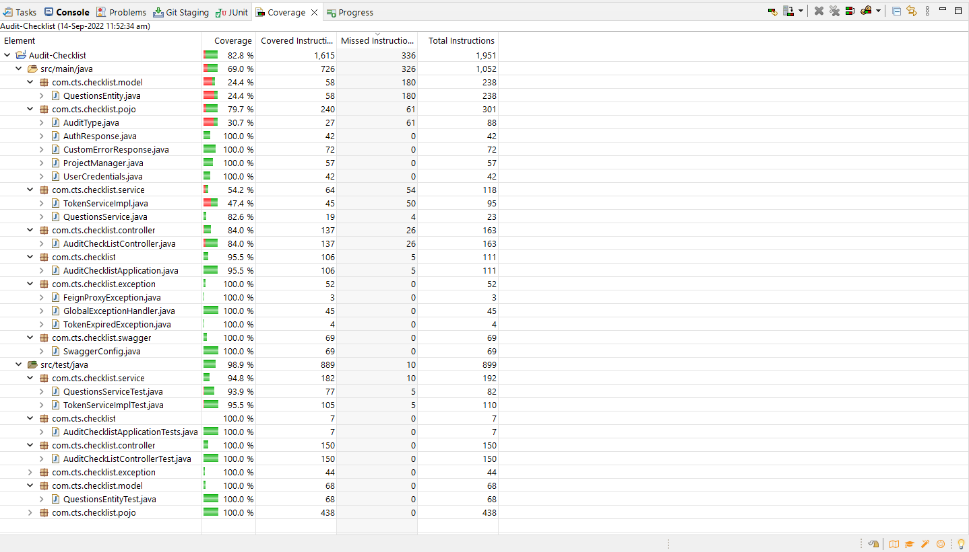
CODE COVERAGE

Slide 27
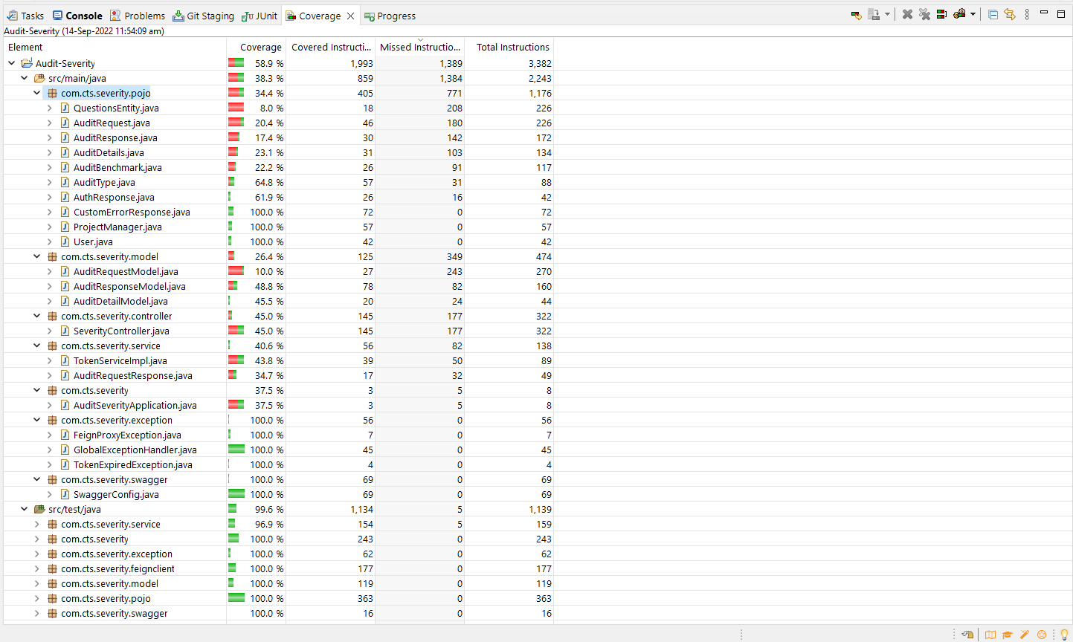
CODE COVERAGE

Slide 28
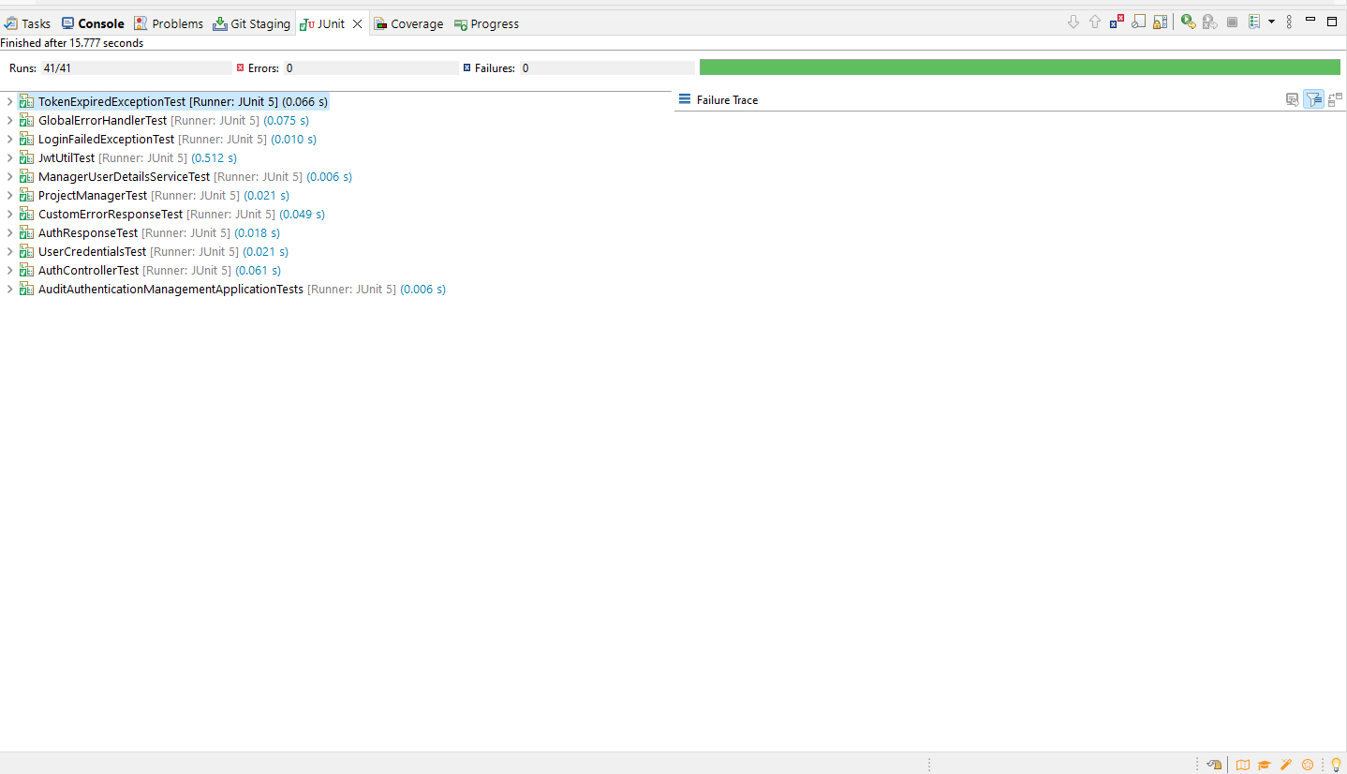
JUNIT

Slide 29
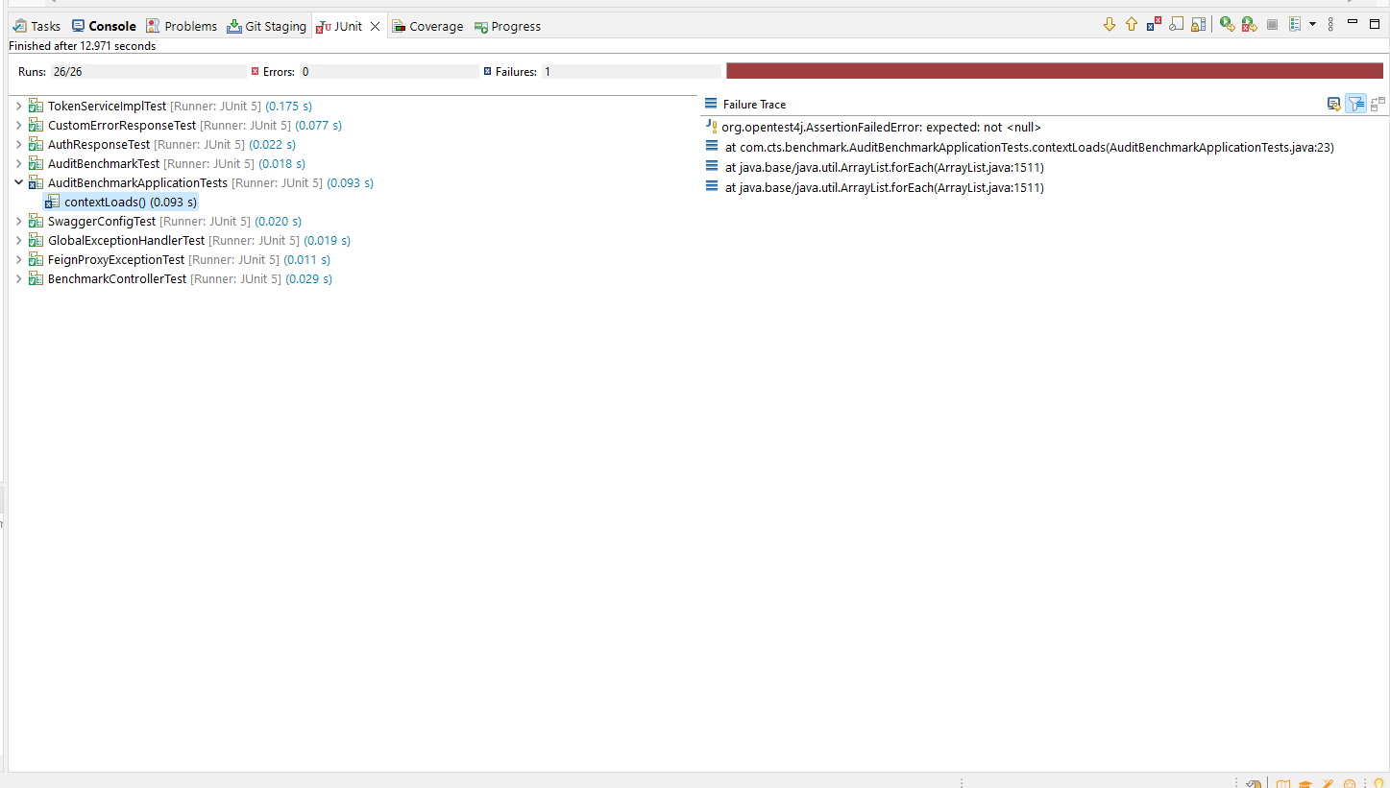
JUNIT

Slide 30
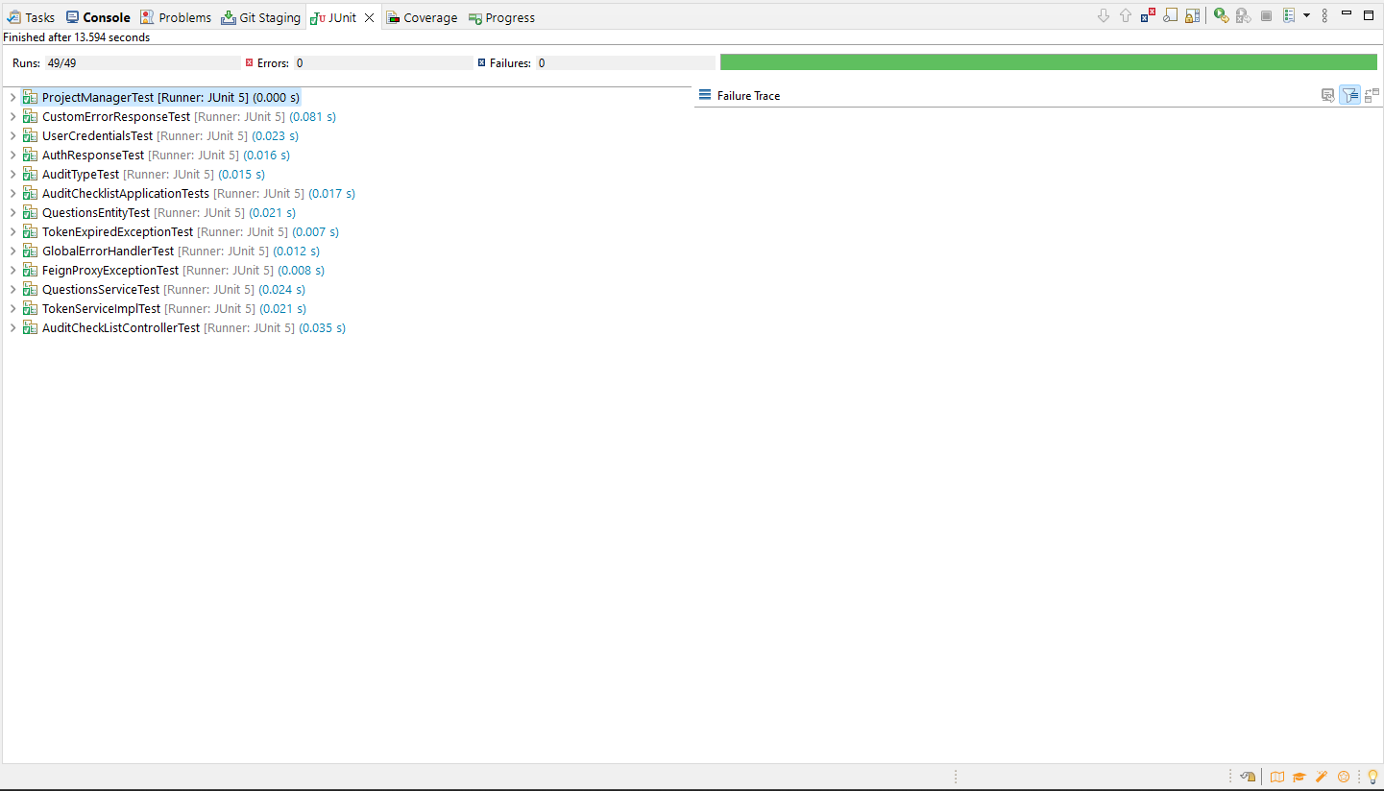
JUNIT

Slide 31
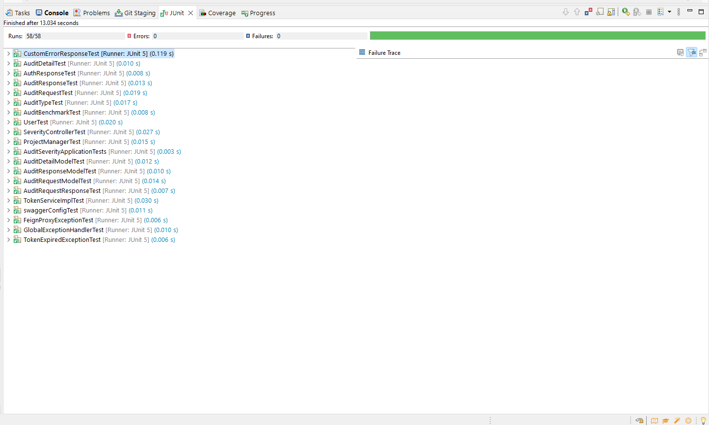
JUNIT

Slide 32
DEPLOYMENT LINKS
AWS Deployment Link
Private Repo GitHub

Slide 33
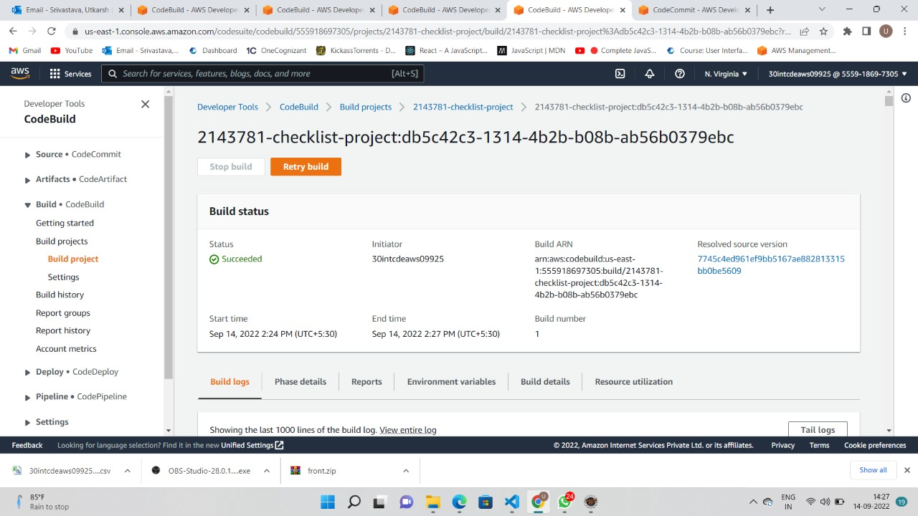
AWS DEPLOYMENT

Slide 34
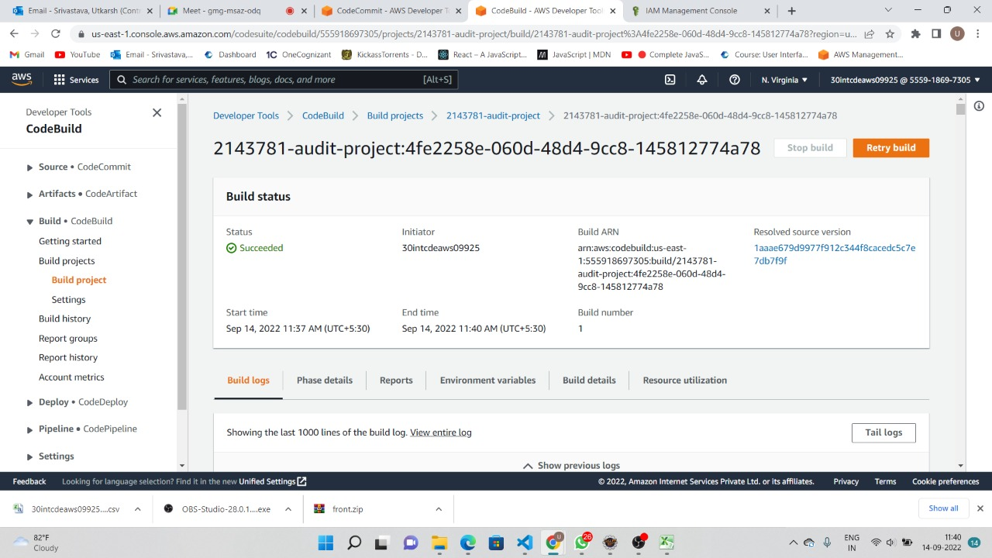
AWS DEPLOYMENT

Slide 35
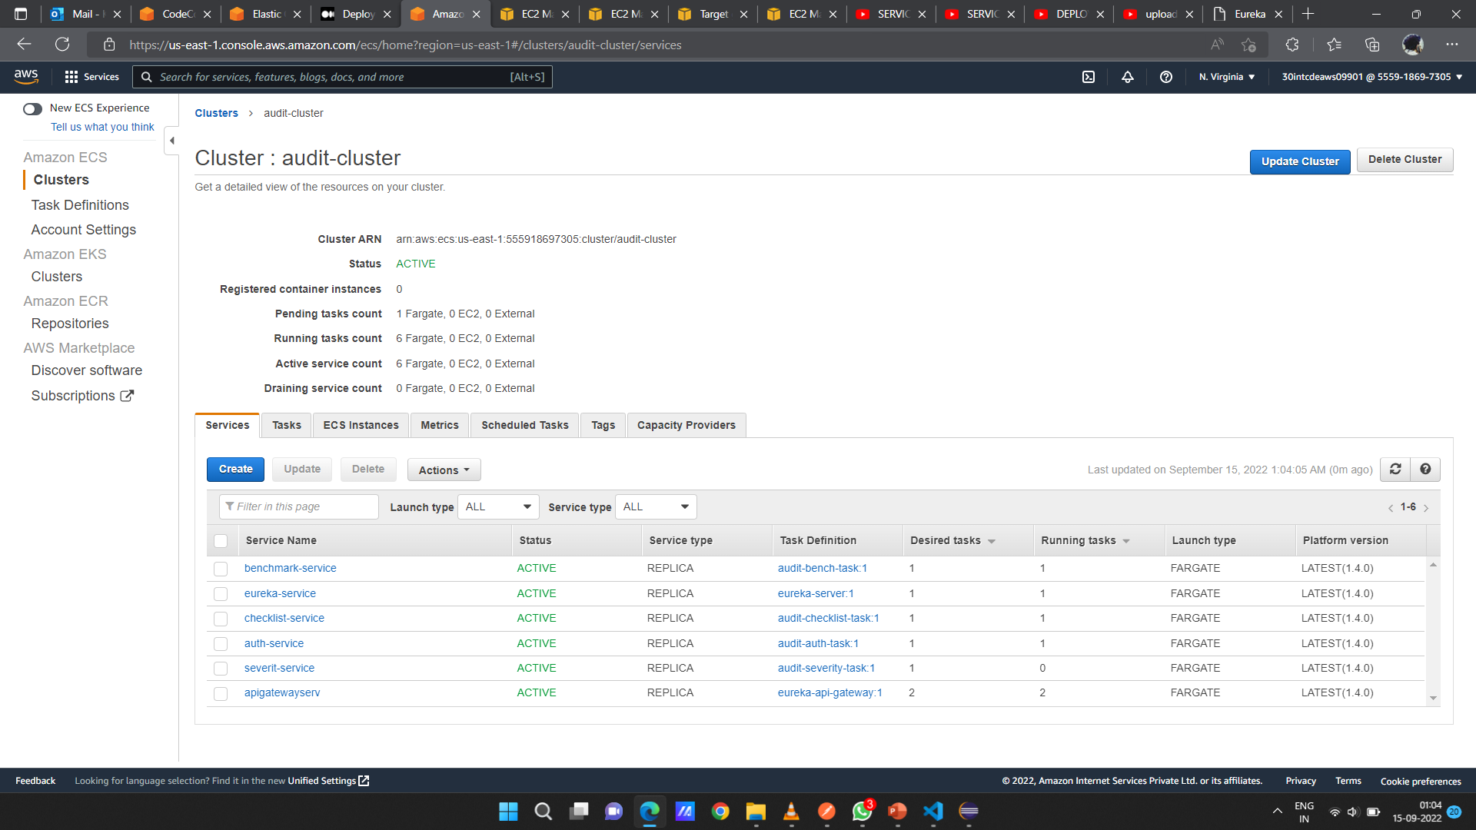
AWS DEPLOYMENT

Slide 36
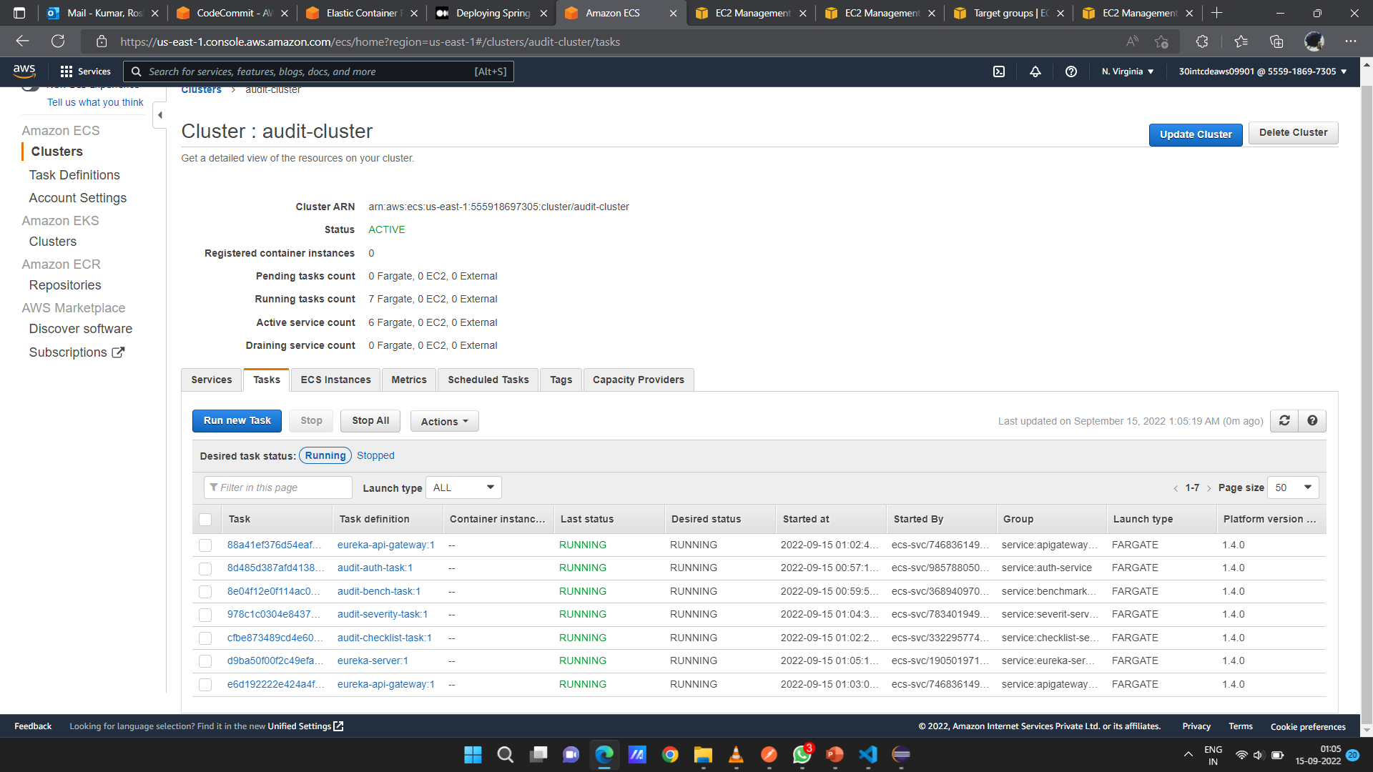
AWS DEPLOYMENT

Slide 37
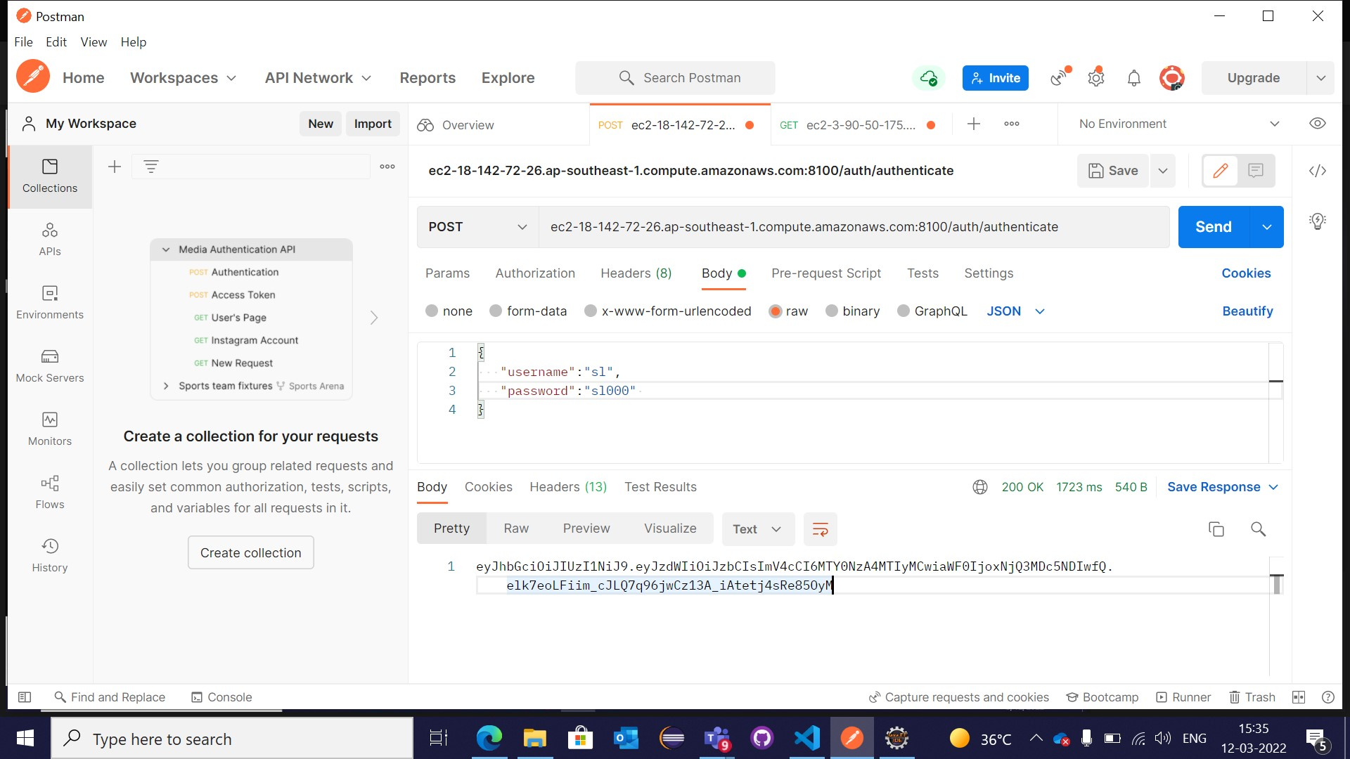
POSTMAN

Slide 38
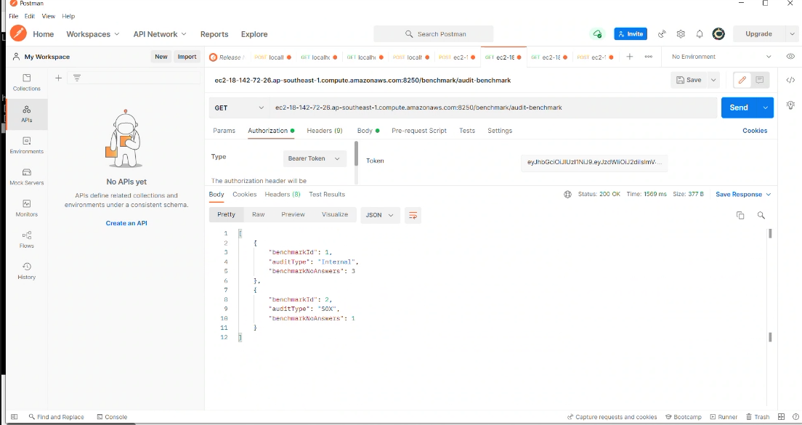
POSTMAN

Slide 39
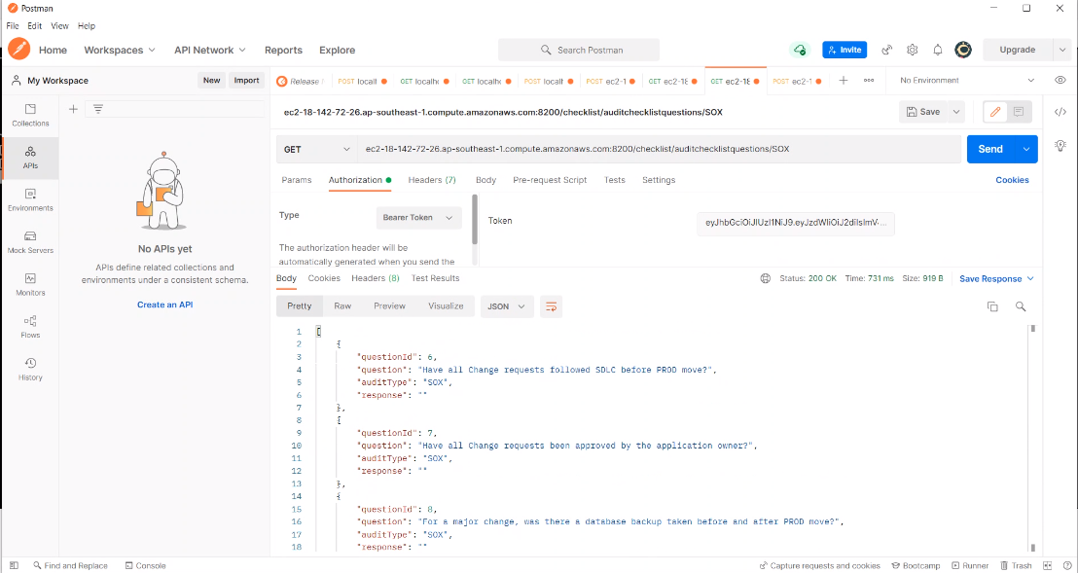
POSTMAN

Slide 40
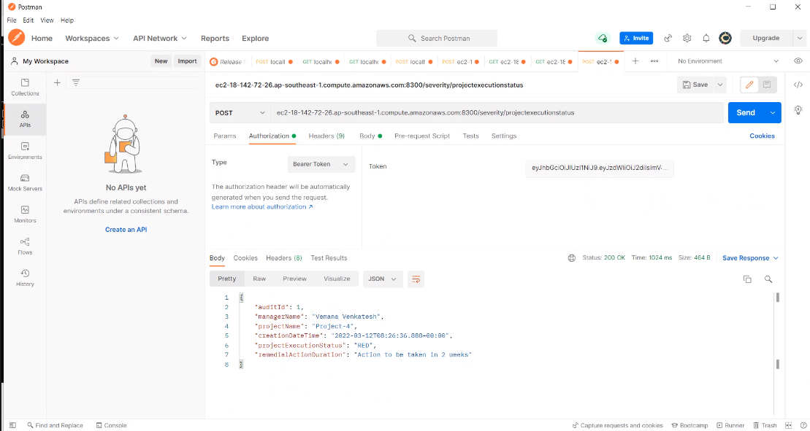
POSTMAN

Slide 41
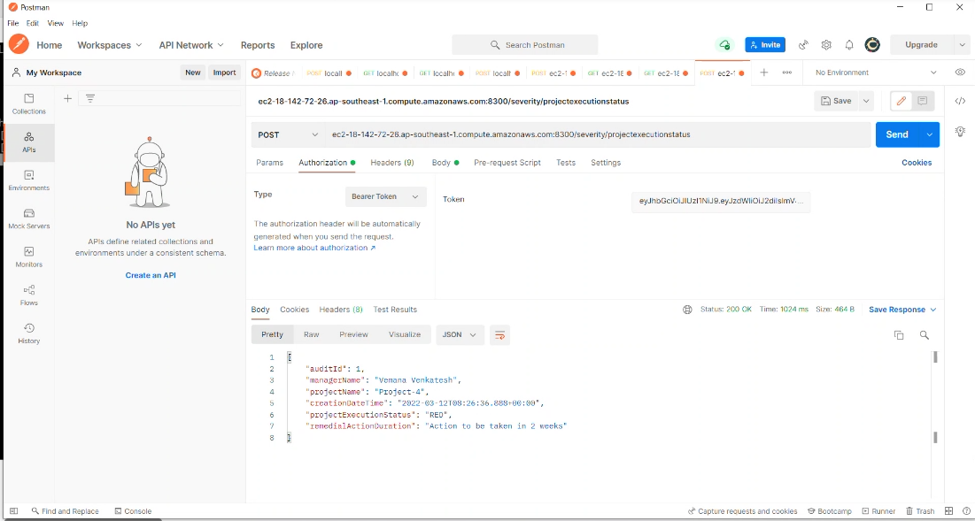
POSTMAN

Slide 42
Learning Outcomes
Learn
Learn from each other
Time
Time management, collaborative learning
Develop
Develop attitude necessary for success
Integrate
Integrate theory and practice
Assess
Assess interests and abilities in FSE field
Develop
Develop communication and interpersonal skills
Build
Build a record of work experience

Slide 43
THANK YOU

